Slide 1

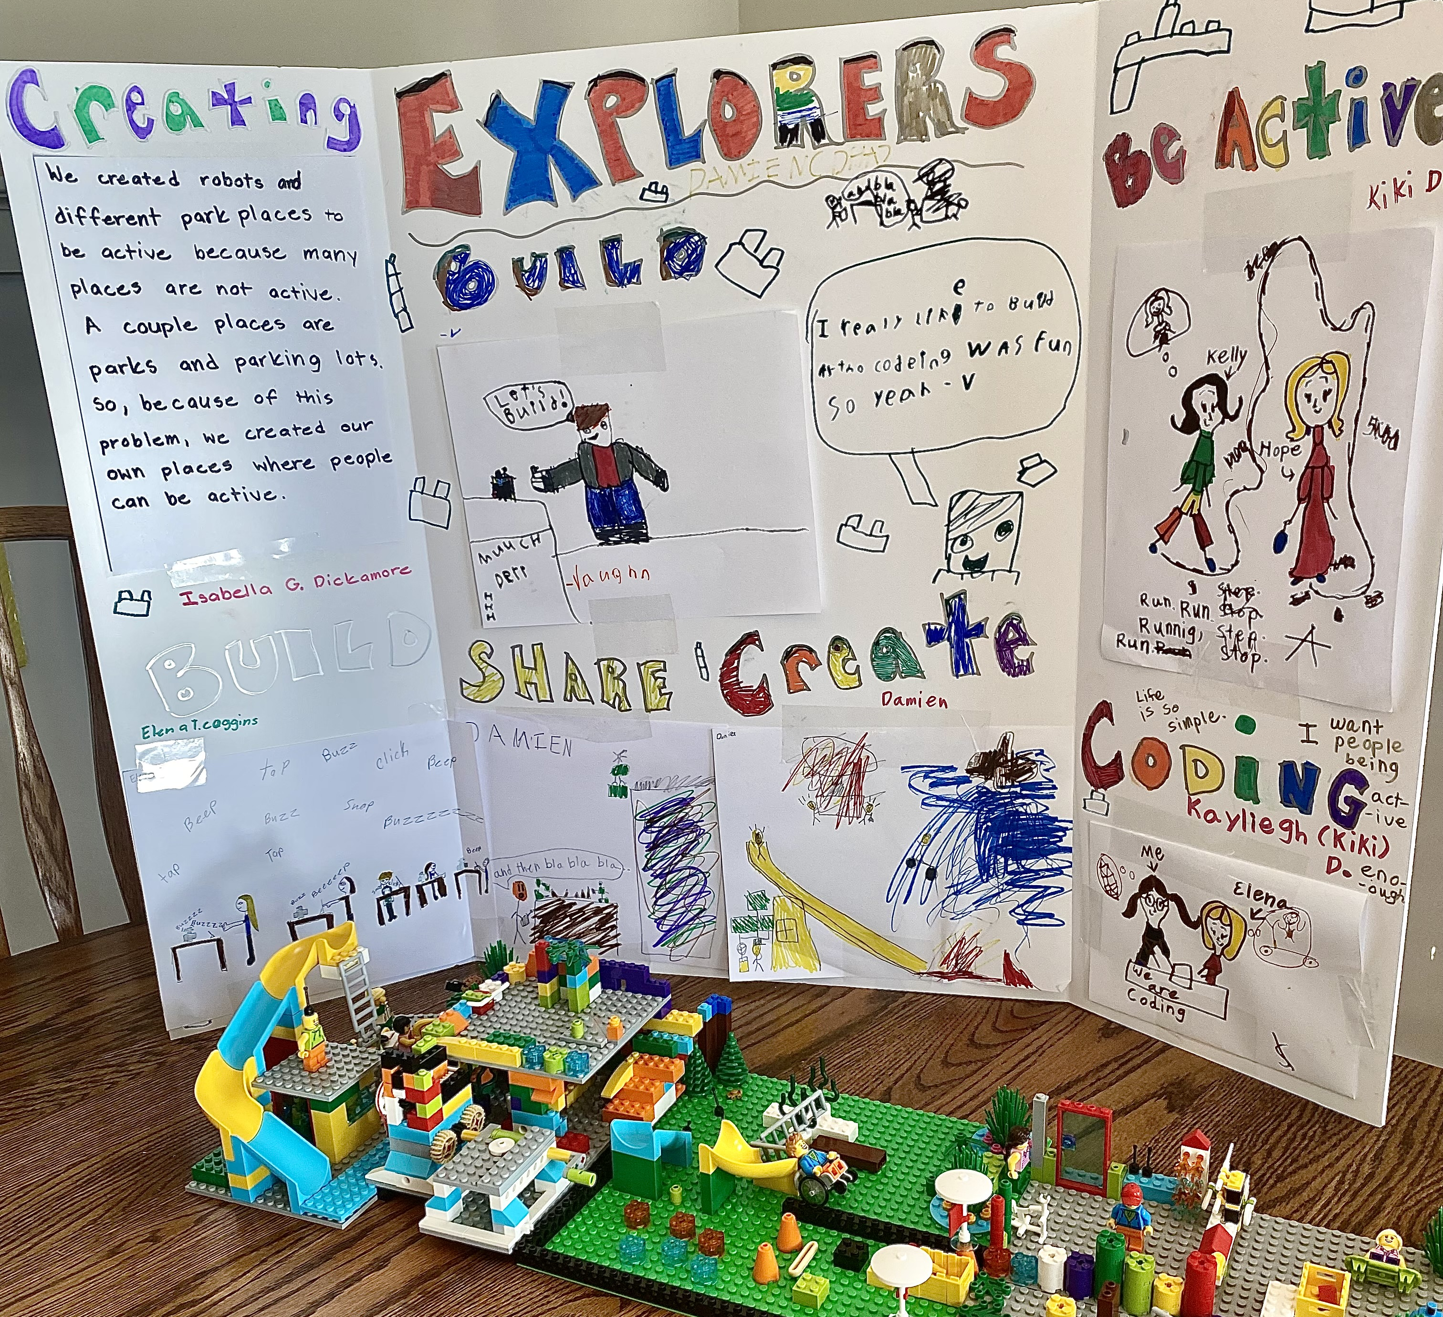
SESSIONS 12
Prepare for Event

Slide 2
Guiding Questions
Can you explain the code you created for your motorized part?
How does your team model relate to the CARGO CONNECTSM theme?
Outcomes
The team will reflect on their CARGO CONNECTSM experience.
The team will create a plan for what to share at their final event.
How will you present your poster and model at the event?
How do we show Core Values?
Notes:
Each session has Guiding Questions that can be shared to frame the session.​
Session Tips
Go over the reviewing sheet and reviewing questions (found here: firstlegoleague.org/season) with your team.
Ask the team the reviewing questions and practice the responses they would give the reviewers.
If you are not attending an official festival, you can still run your own festival or have an informal sharing event.
Every question on this page doesn’t need to be answered. They are just to help your team feel ready for the event.
Provide extra scrap paper for the team to write out what they plan to share at their event.

Slide 3


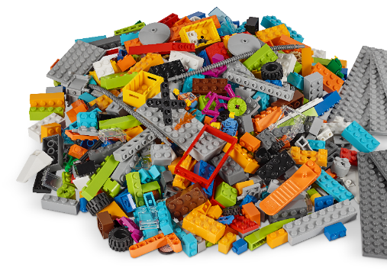
Introduction – Impact Build
Examples of Impact
Ask the students to provide examples of Impact and record them here
Example of Impact
Example of Impact
We applied what we learned to improve our world.
Notes:
***Skip this slide during session 9***
Introduction
Teamwork and Fun Builds
(10 minutes)
Have the team provide examples of how they have used teamwork (Session 8) and fun (Session 9) throughout the sessions.
Have the team create a build from the prototyping pieces representing this Core Value or examples of the team using teamwork and fun.

Slide 4


Tasks
You will be taking
part in a FIRST® LEGO®
League Explore Festival.
Invite your family and
friends to your special
event!
Share what you
have learned and
how your team
had fun!
Notes:
Tasks (40 minutes)
Gather your completed team model and team poster.
Talk about what your team would like to share at your event!
Complete the next page to prepare for your event.
Look over the reviewing sheet with your coach.

Slide 5
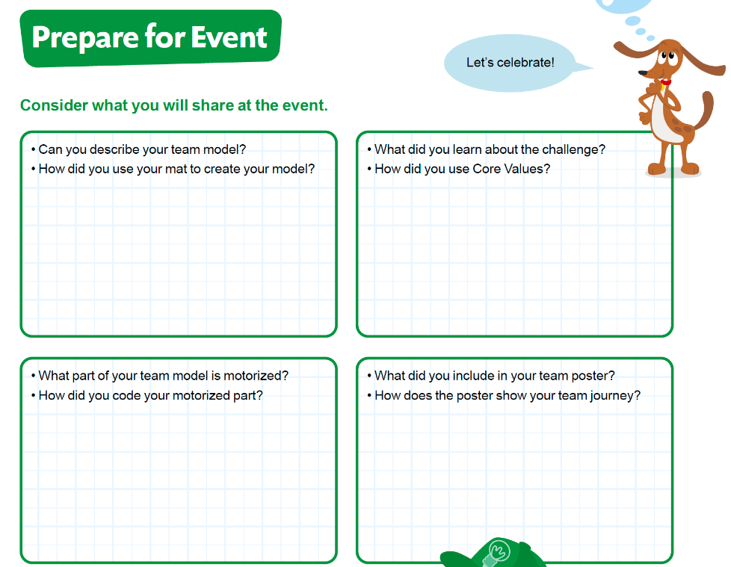
Tasks
Complete page 27 in your Engineering Notebook to prepare for your event.
Notes:
Tasks (40 minutes)
Gather your completed team model and team poster.
Talk about what your team would like to share at your event!
Complete the next page to prepare for your event.
Look over the reviewing sheet with your coach.

Slide 6
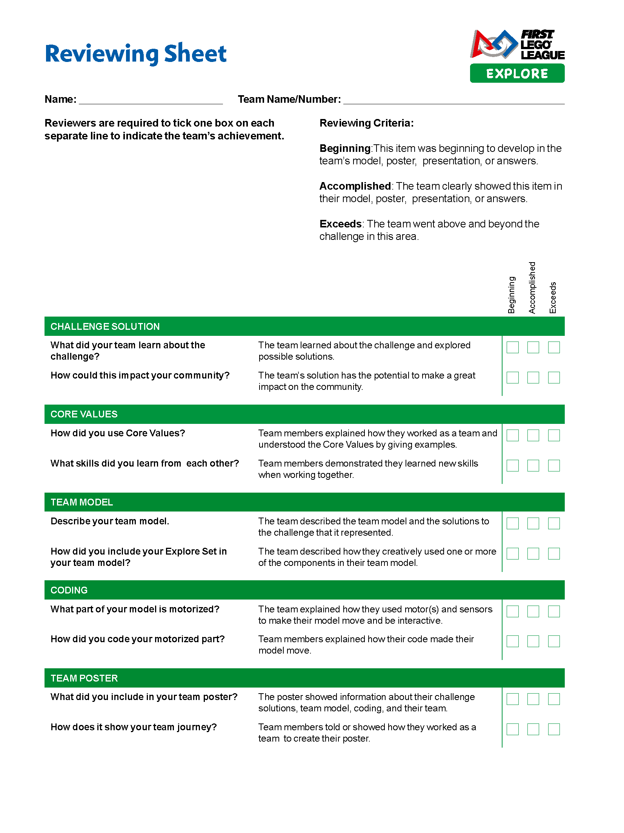
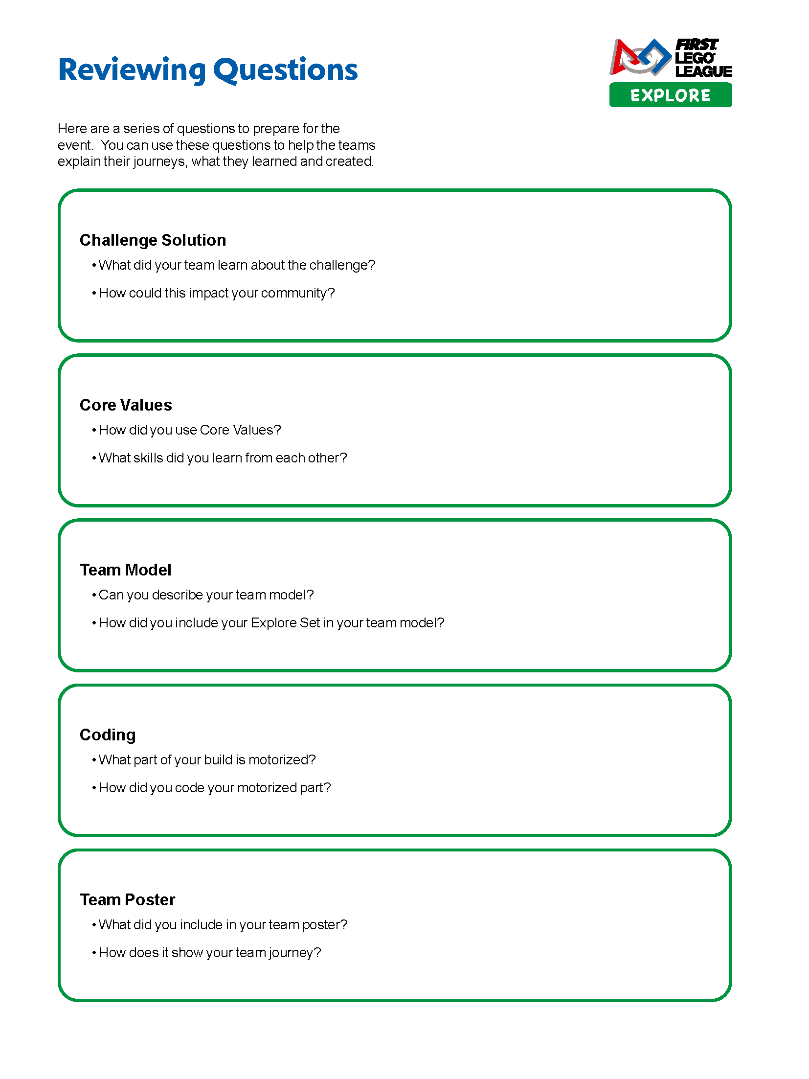
Tasks
Look over the reviewing sheet with your coach.
Notes:
Tasks (40 minutes)
Gather your completed team model and team poster.
Talk about what your team would like to share at your event!
Complete the next page to prepare for your event.
Look over the reviewing sheet with your coach.

Slide 7
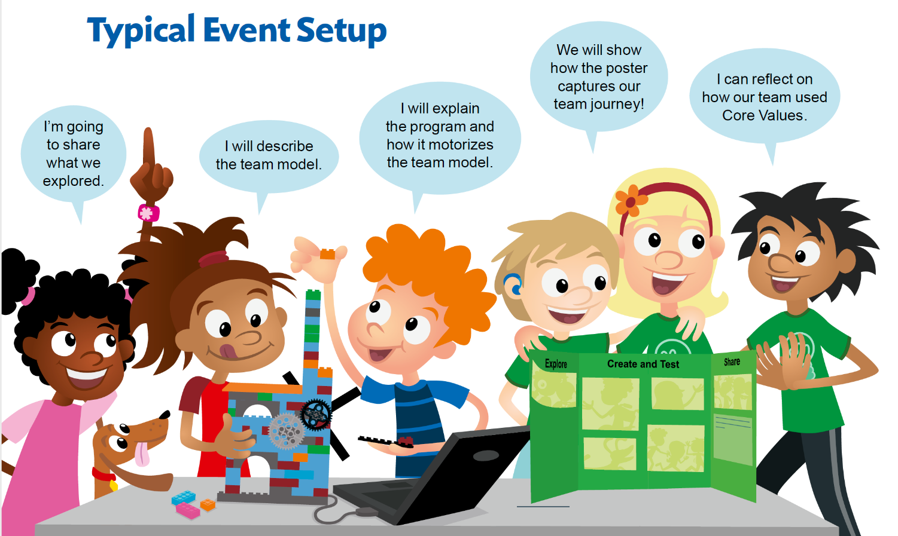
Notes:
Tasks (40 minutes)
Gather your completed team model and team poster.
Talk about what your team would like to share at your event!
Complete the next page to prepare for your event.
Look over the reviewing sheet with your coach.

Slide 8

Share
Practice your team poster presentation.
Practice your team model presentation.
Notes:
Share (10 minutes)
Have the team:
Practice their team poster presentation.
Practice their team model presentation.

Slide 9

Optional Video:
You may wish to embed a relevant, age-appropriate video for your students here. See the Notes for an example.
Notes:
Choose a relevant, age-appropriate video for your students.
In this session, you could show a video with some tips on giving presentations.
Here are two examples made by middle school students:
Schooled by Kids: Presentation Skills, Part 1: https://youtu.be/8IbheB2-ixM
Schooled by Kids: Presentation Skills, Part 2: https://youtu.be/PX_DAFXQxpc

Slide 10
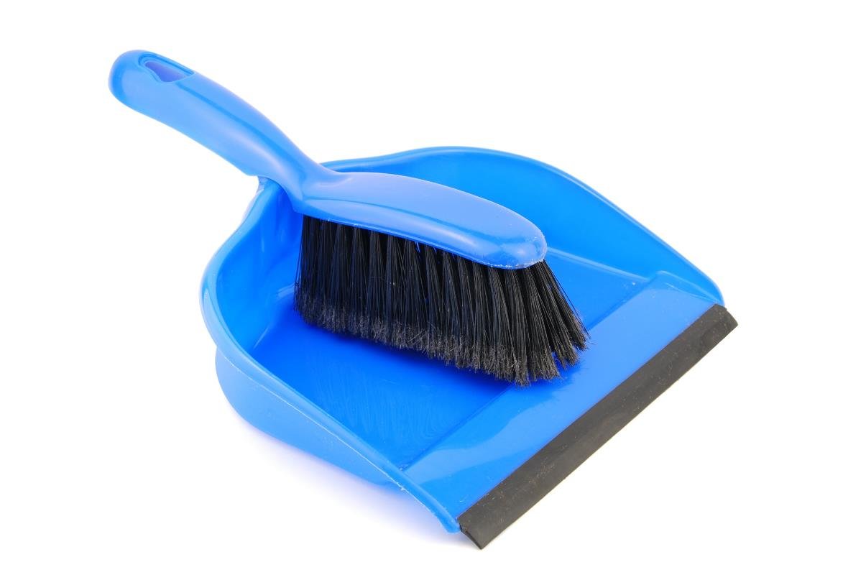
Clean Up
Notes:
You may wish to play a video or song during clean up time Link on GoNoodle: https://family.gonoodle.com/activities/clean-up. Link on YouTube Kids: https://www.youtubekids.com/watch?v=ZJFk87ZsHn0 . Link on Youtube: https://youtu.be/ZJFk87ZsHn0
Cleanup Pointers
Make sure the team model and team poster are stored and ready to be transported to the event.
Check that you have the device, charging cord, and fully charged battery for the event.

Slide 11
FIRST® and the FIRST® logo are registered trademarks of For Inspiration and Recognition of Science and Technology (FIRST). LEGO® is a registered trademark of the LEGO Group. FIRST® LEGO® League and CARGO CONNECTSM are jointly held trademarks of FIRST and the LEGO Group. All other trademarks are the property of their respective owners. ©2021 FIRST and the LEGO Group. All rights reserved.

